Slide 1
Agile Presentation
William Franke

Slide 2
Key Facets of the Scrum-Agile Approach
Source (1)
The purpose of scrum is to break down large project into smaller more manageable tasks which are completed in short iterations called sprints. There are six principles to scrum.
  Control over Empirical Process
    Based on the observation of hard evidence over theory, The three main idea of empirical evidence process control are transparency, inspection, and adaptation.
  Self-Organization
    Since the scrum process relies on so many people, everyone works independently. This principle makes it easier to assess individual contributions.
  Collaboration
    Collaboration is imperative for success of the project. This principle focuses on three dimensions of collaborations: awareness, articulation, and appropriation.
  Value-Based Prioritization
    Involves organizing and prioritizing tasks based on their value.
  Time-Boxing
    Ensures everyone involved know how much time is allocated to each step.
  Iterative Development
    Allows the team to adjust and manage change easier.

Slide 3
Agile Team Roles
Source (2)
Scrum Master – A servant leader who supports the scrum team and describes what they do daily.
  Support product owner by communicating value, managing backlog, planning the work for the team, and breaking down that work to deliver the most learning.
  Supports the development team by self-organizing, focus on outcomes, get to a “done increment”, and manage blockers.
  Serves their organization with helping them understand scrum.
Product Owner – Understand the customer and business requirements and create and manage the product backlog.
  Understand the entire backlog of a project.
  Communicate with stakeholders (users, customers, leadership).
  Balances feedback from stakeholders and highest priority features for development team.
Development Team – Team that does the work, comprised of many different roles (design, software engineer, UI/UX, tester, etc.).
  Self-organizing so they can make decisions to get work done.
  Deliver work throughout the sprint.
  Meet at daily scrum to share updates on work, seek help if needed, and highlight issues or blockers in their daily work.

Slide 4
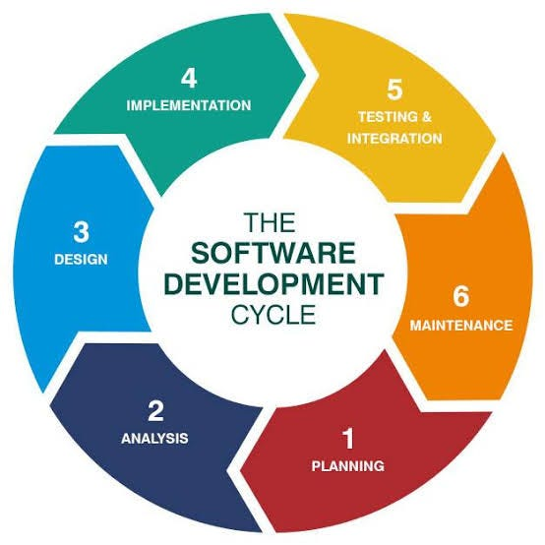
Software Development Life-Cycle (SDLC)
Source (3)
Planning – Stakeholders and project managers define the software's purpose, scope, and timeline.
Analysis – Requirements are analyzed for feasibility and clarity.
Design – The software blueprint is created.
Implementation – Start coding the software.
Testing – Rigorous testing to identify issues/bugs and fixing those issues.
Deployment – The software is handed over to the user either fully or in increments.
Maintenance – Updates and modifications to the software on a regular basis.
How SDLC works with Scrum-Agile
Development is broken into timed iterations called sprints that last anywhere from two to four weeks. The number of sprints can vary for each project.
Each sprint is a mini-SDLC in a condensed time frame.
Sprint Review and Sprint Retrospective happen at the end of the sprint, during the maintenance phase, for continuous improvement.
  Sprint Review – Gather feedback from stakeholders and adapt product backlog for future sprints.
  Sprint Retrospective – The scrum team reflects on previous sprint to identify what went well, what didn’t, and how to improve future sprints.

Slide 5
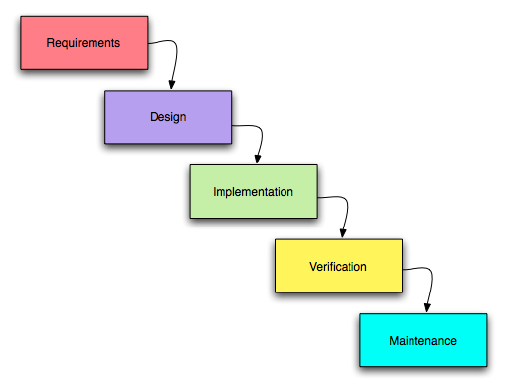
Waterfall Method
Source (4)
The waterfall method has a sequential flow of phases. Once one is completed you can move onto the next phase. This makes it a highly rigid and structured development method.
  Pro’s
    Since it is a linear development method it is very easy to understand.
    Waterfall requires intense documentation before moving on. This helps when moving onto the maintenance phase.
  Con’s
    Unlike agile, waterfall is one linear development model. This means the team is unable to go back in stages. This makes changing features very hard.
    Waterfall does not involve the client until the end of the project. This can lead to misunderstandings and dissatisfaction with the client.
Image from https://commons.wikimedia.org/wiki/File:Waterfall_model.png

Slide 6
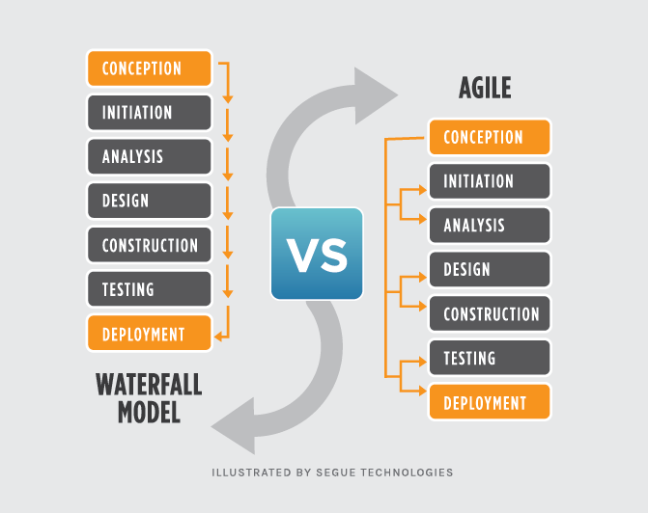
Waterfall or Agile method
We have gone over the different development methods, but what is the right choice for your project?
If your project has these characteristics, Agile is the better method for your project.
  Requirements are not full known and there is some uncertainty to the project.
  Customer wants communication throughout the development process.
  Need for incremental features to be delivered.
  Agile specializes in breaking down large complex projects.
If your project has these characteristics, Waterfall is the better method for your project.
  Requirements are clearly defined and will not change.
  Customer wants no involvement in the process and wants final product delivered at the end.
  Works for large projects but timeline and requirements cannot be changed during development.
Image from https://www.seguetech.com/waterfall-vs-agile-methodology/

Slide 7
References:
Ferreira, A. (2023, October 30). Deep Dive: The software development life cycle (SDLC) in Agile Environments | by Alessandro Ferreira | Medium. Deep Dive: The Software Development Life Cycle (SDLC) in Agile Environments. https://medium.com/@argferreira1/deep-dive-the-software-development-life-cycle-sdlc-in-agile-environments-6b245bbea5ab (3)
GeeksforGeeks. (2025, July 23). Agile vs waterfall project management. GeeksforGeeks. https://www.geeksforgeeks.org/software-engineering/agile-vs-waterfall/ (4)
West, D. (2025). Agile scrum roles and Responsibilities. Atlassian. https://www.atlassian.com/agile/scrum/roles (2)
What is Scrum?. UAGC. (2025, March 6). https://www.uagc.edu/blog/what-is-scrum (1)

